Slide 1


Angular 8 - Intermediate Level
Wipro
1

Slide 2
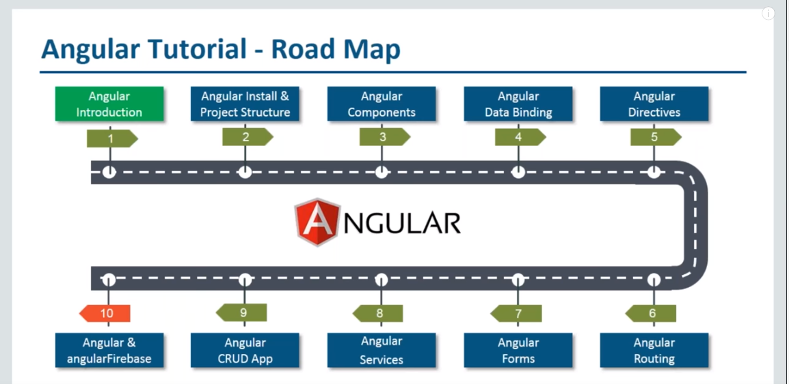
Modularity
Typescript support
Also different Angular versions
Role of components
How to create the components
How to use it in Angular
1. Mechanism to connect your User application interface and Business Logic
Different Directives angular provides like ng-if ng-repeat etc..
Also we will learn how to create custom directives
Firebase is a backend service that provides functionalities like filestorage, authentication , database etc..
Service in angular is class that encapsulates some sort of functionality which can be provided to rest of your application
Different ways to implement the form in Angular, along with that how to add validation rules, error handling etc..
Routing helps user for page navigation or section navigation. Actually navigating thru different components

Slide 3
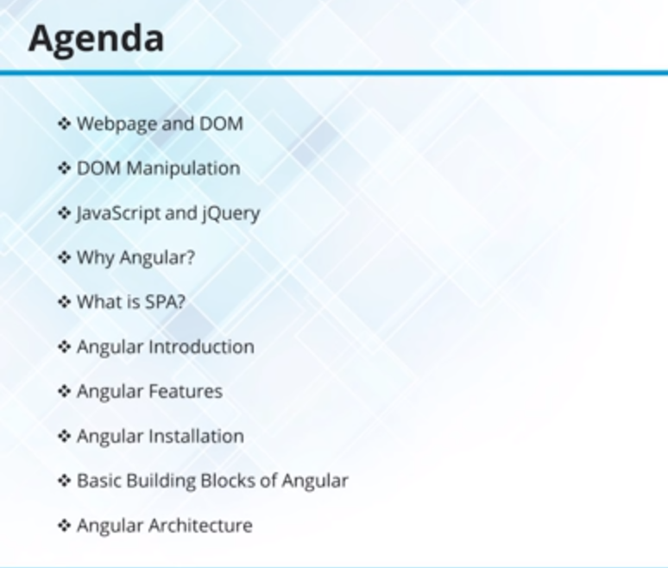

Slide 4
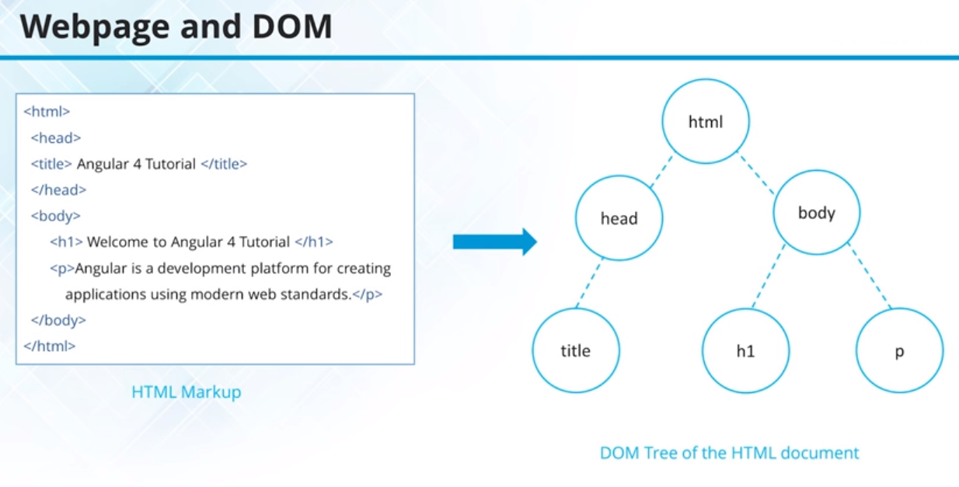

Slide 5
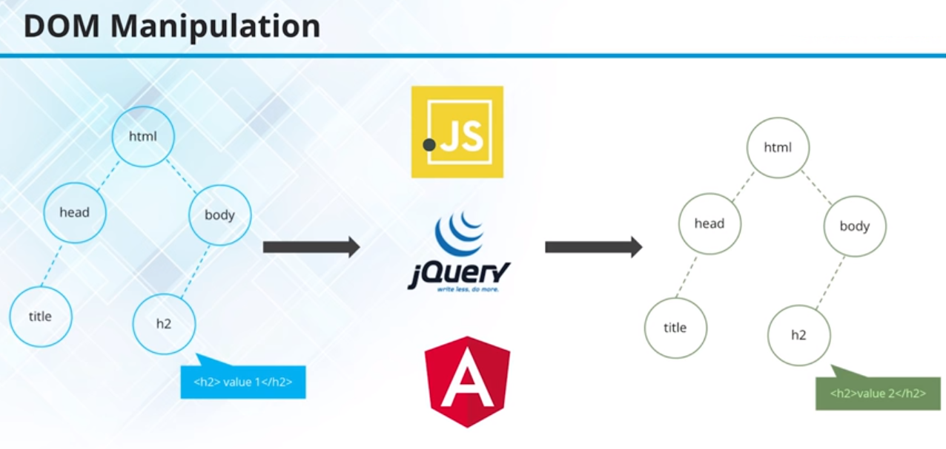

Slide 6
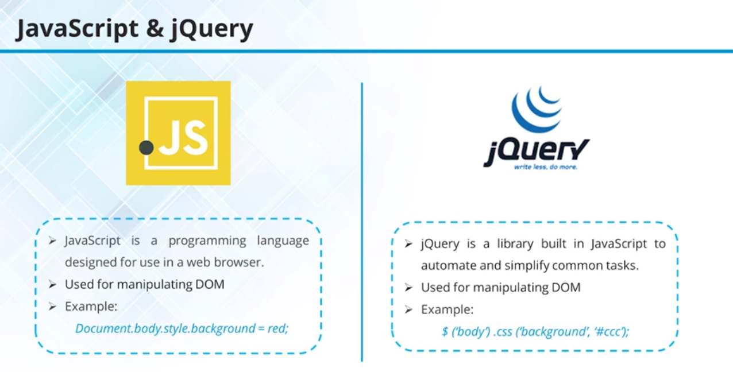

Slide 7
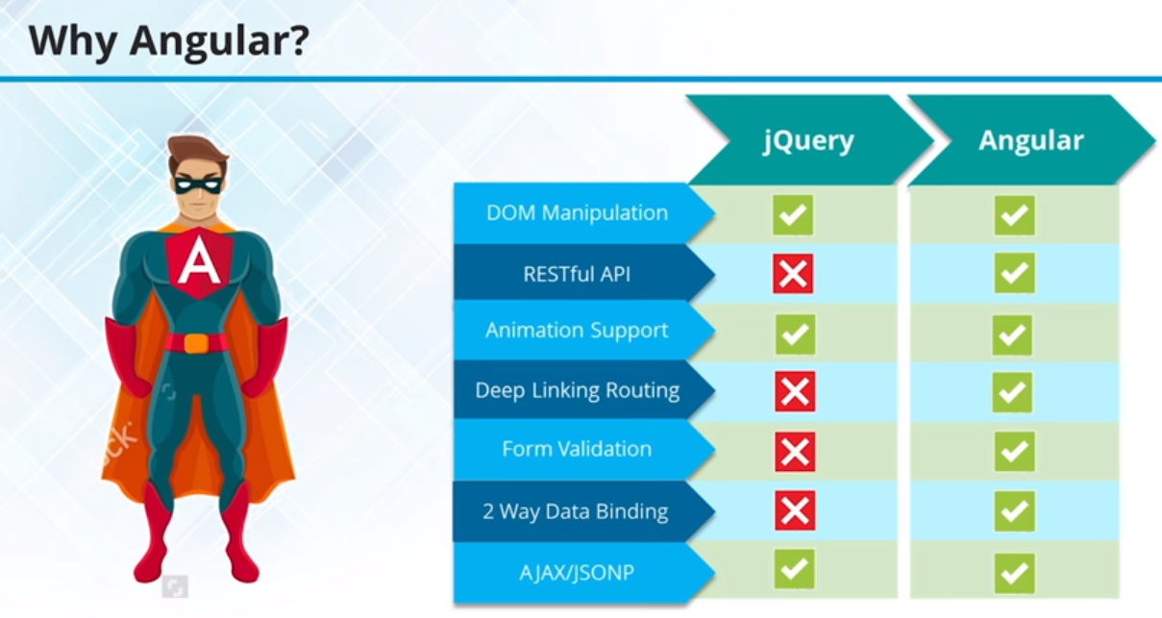

Slide 8
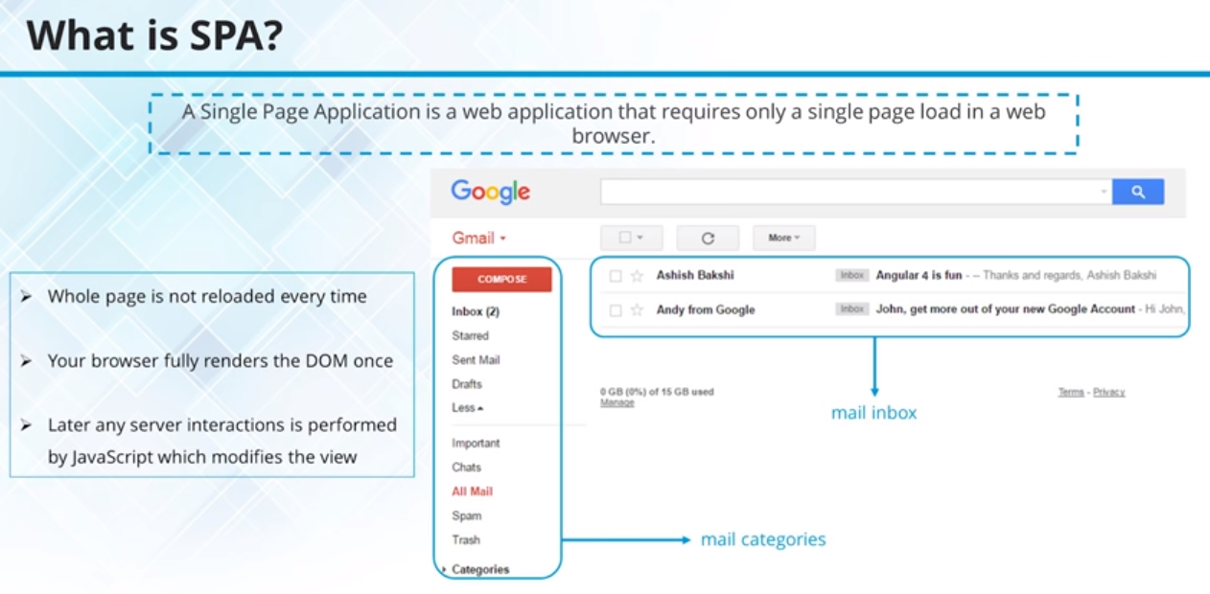

Slide 9
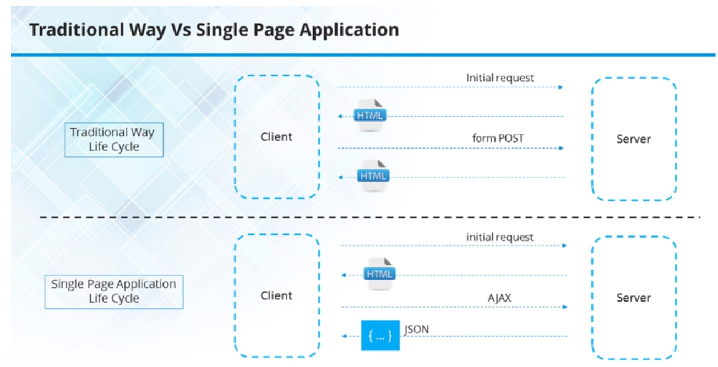

Slide 10
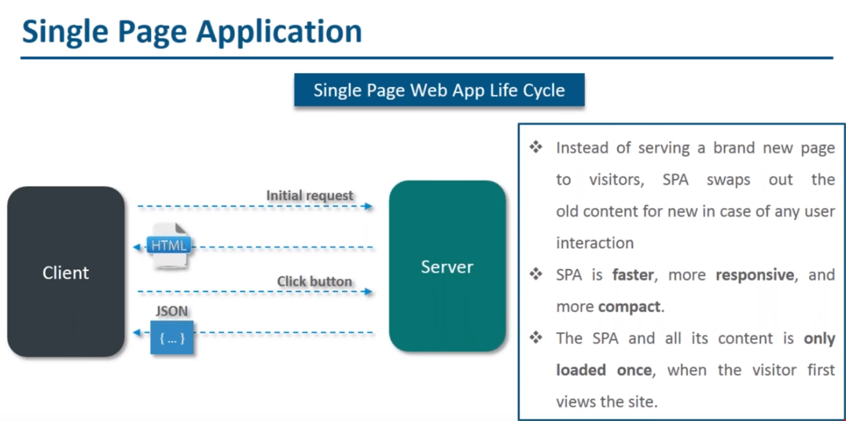

Slide 11
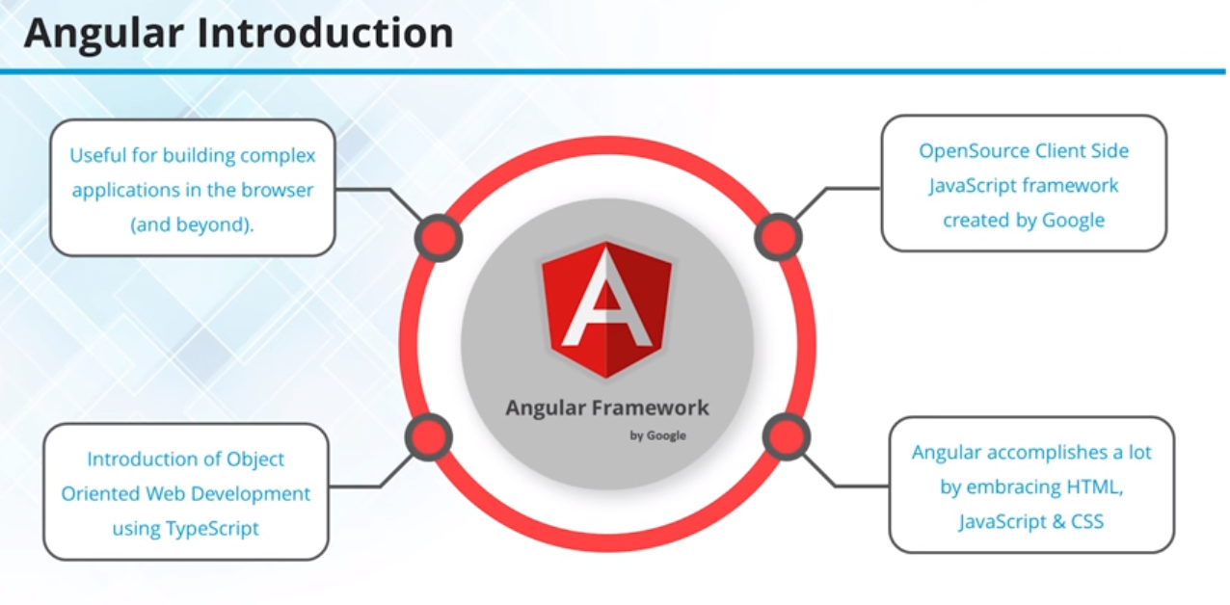

Slide 12
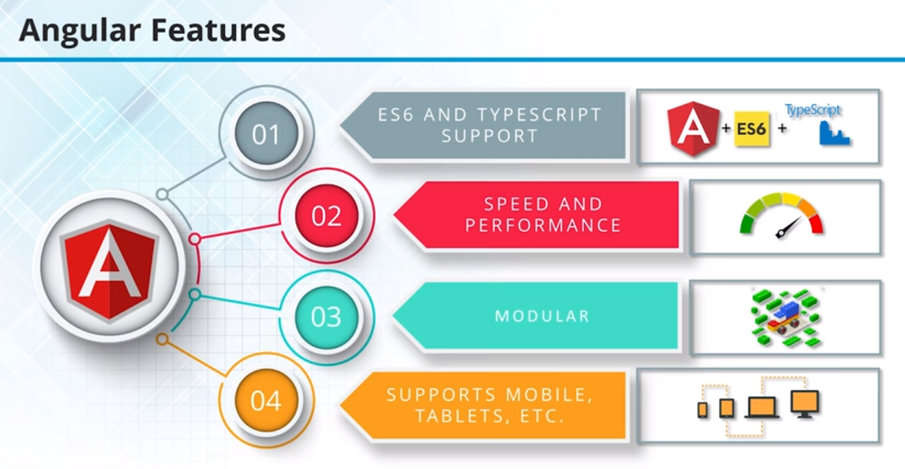

Slide 13
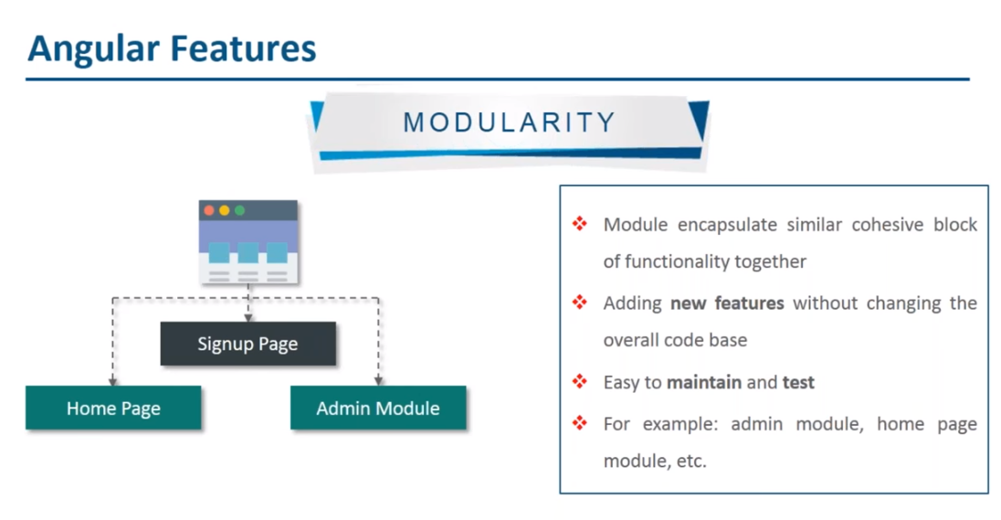

Slide 14
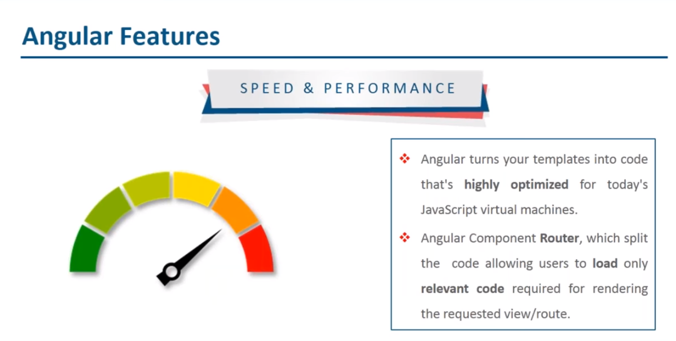

Slide 15
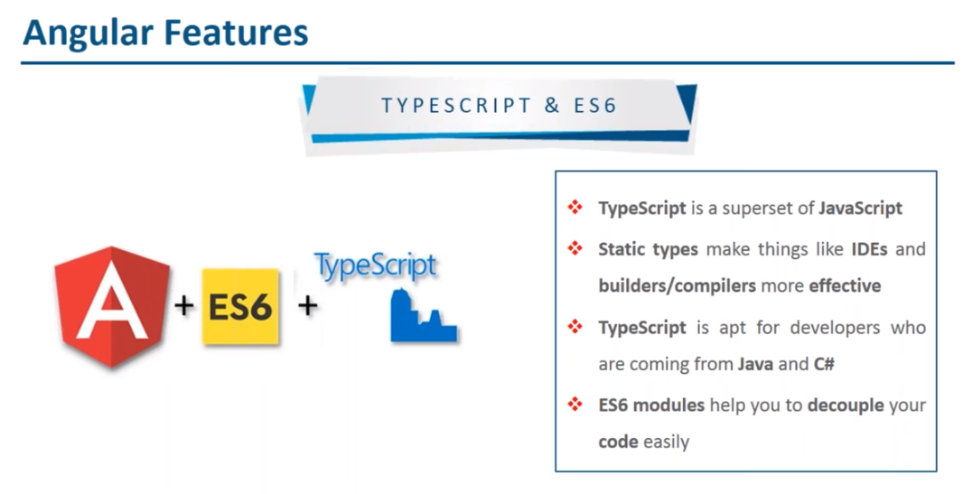

Slide 16
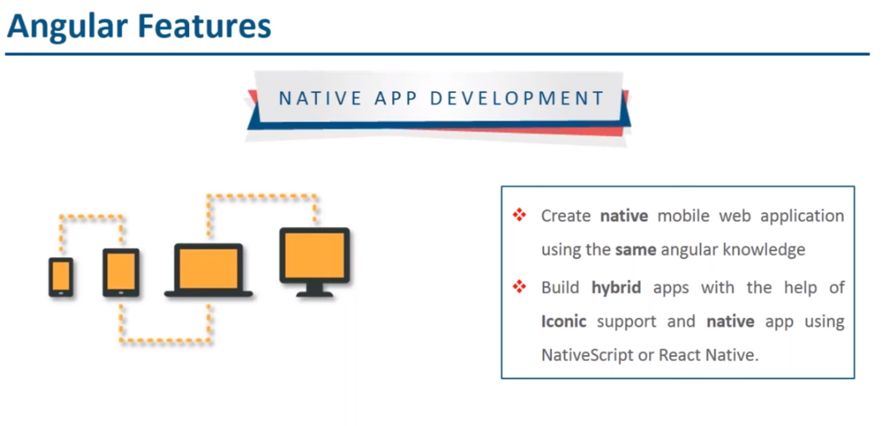

Slide 17
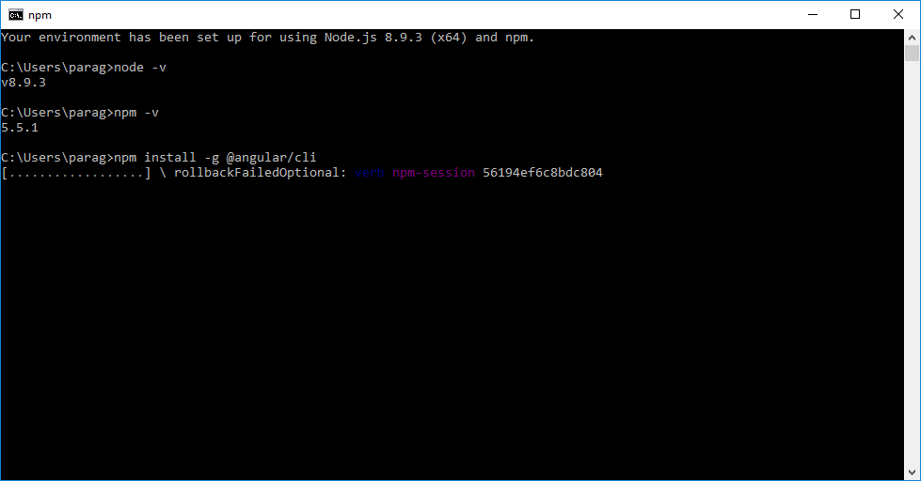
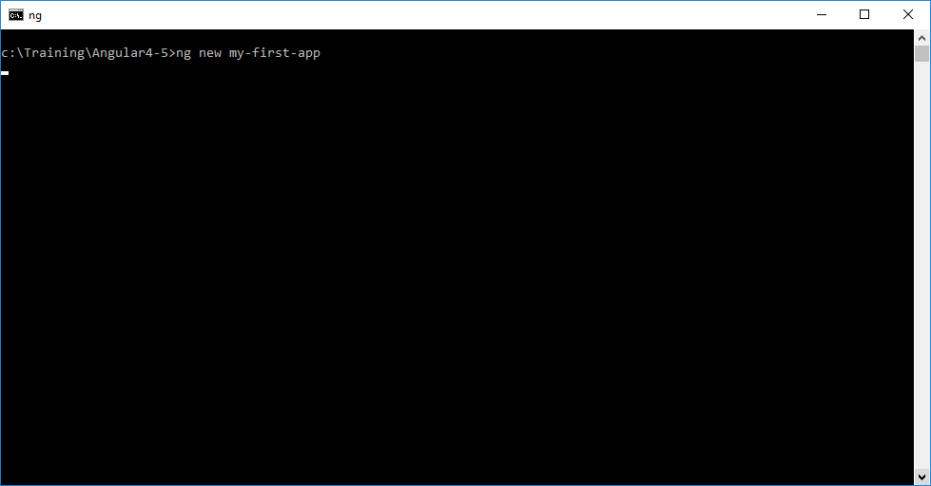

Slide 18
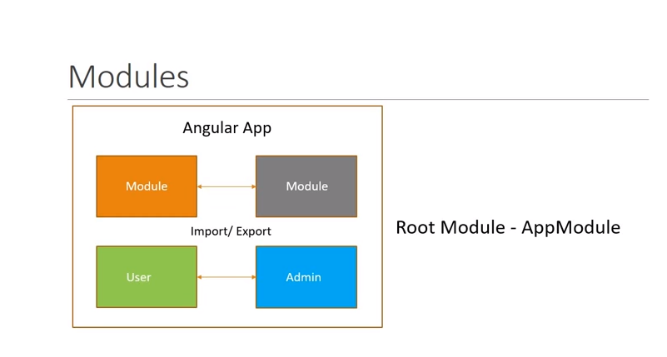

Slide 19
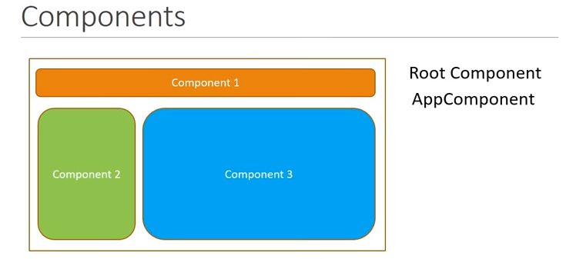
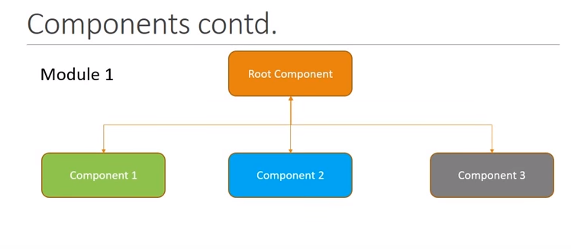
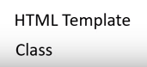

Slide 20
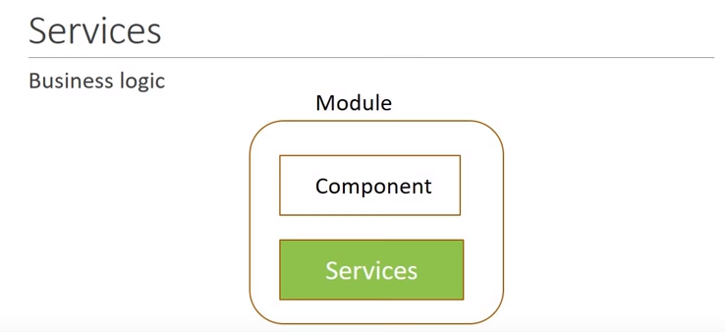

Slide 21
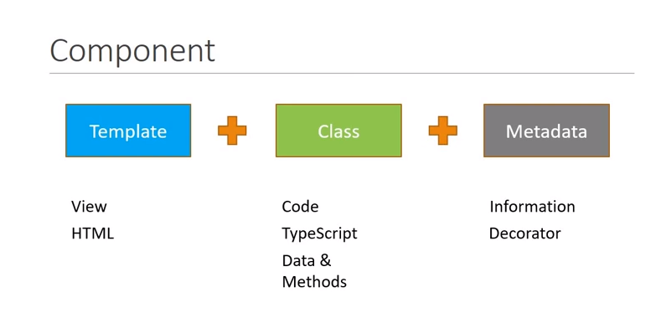

Slide 22
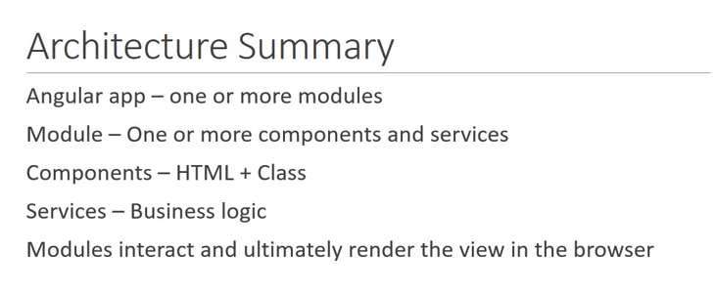

Slide 23
BASIS FOR COMPARISON | CLASS | INTERFACE
Basic | A class is instantiated to create objects. | An interface can never be instantiated as the methods are unable to perform any action on invoking.
Keyword | class | interface
Access specifier | The members of a class can be private, public or protected. | The members of an interface are always public.
Methods | The methods of a class are defined to perform a specific action. | The methods in an interface are purely abstract.
Implement/Extend | A class can implement any number of interface and can extend only one class. | An interface can extend multiple interfaces but can not implement any interface.
Constructor | A class can have constructors to initialize the variables. | An interface can never have a constructor as there is hardly any variable to initialize.

Slide 24
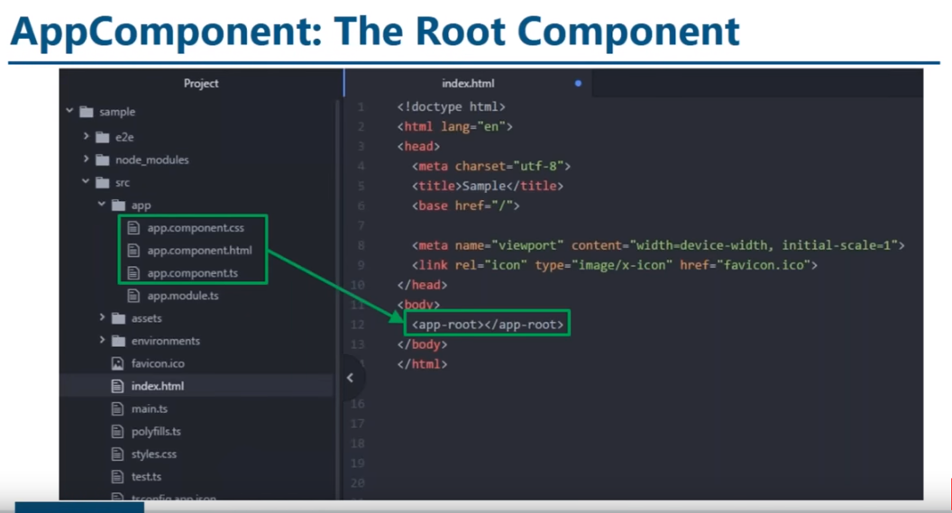

Slide 25
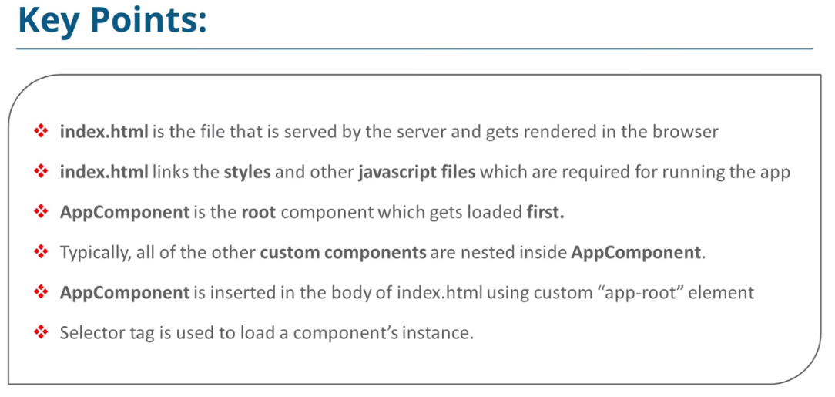

Slide 26
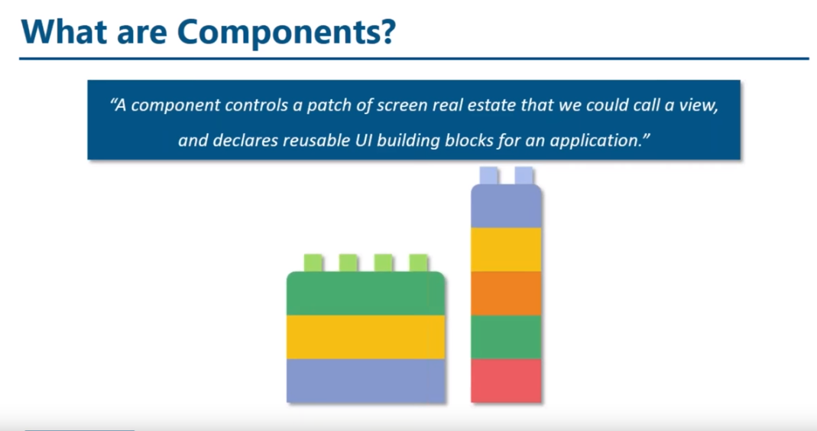

Slide 27
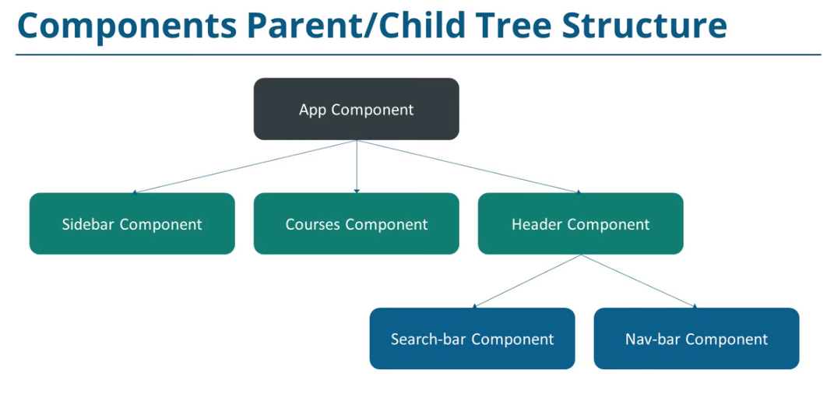

Slide 28
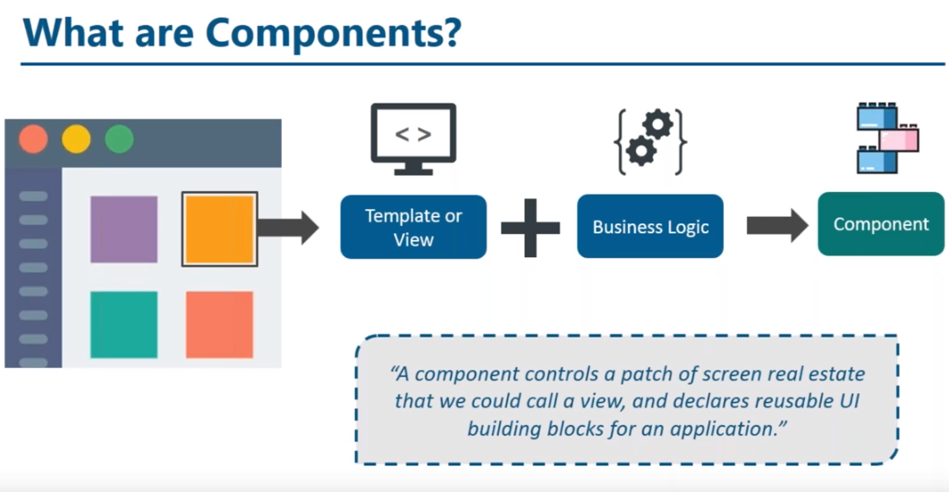

Slide 29
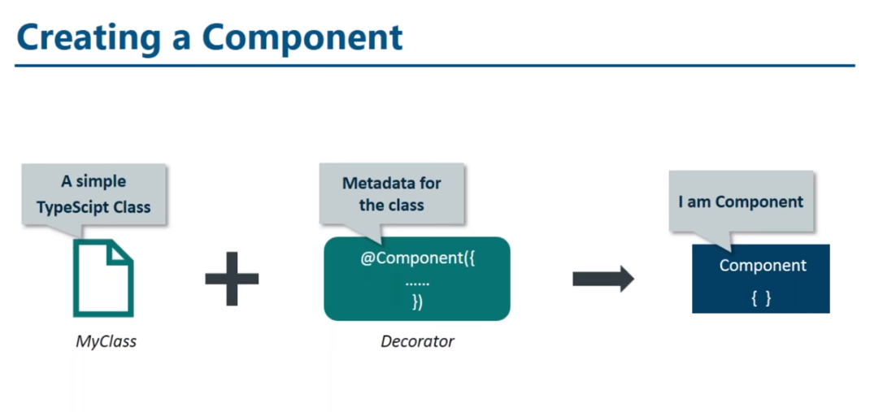

Slide 30
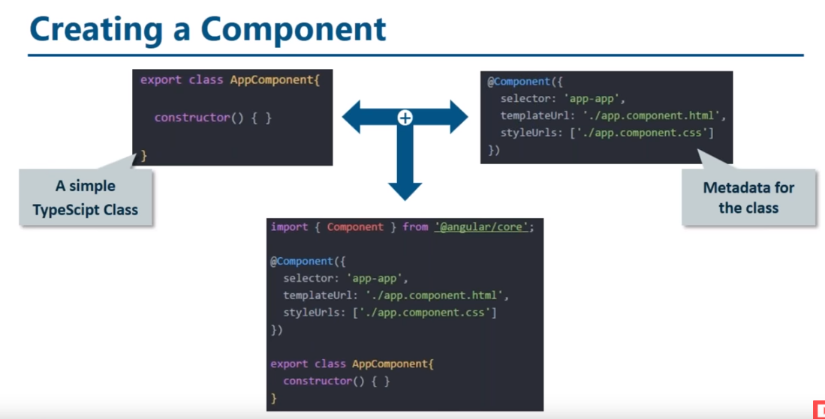

Slide 31
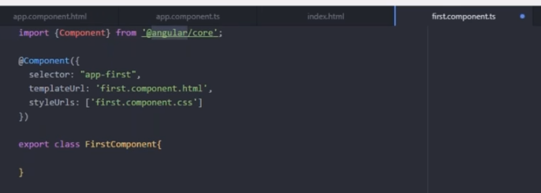
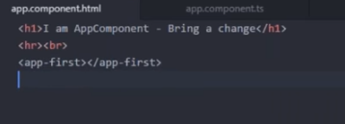
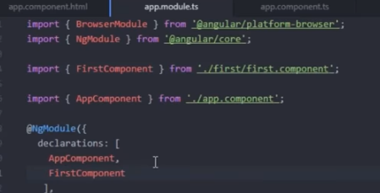

Slide 32
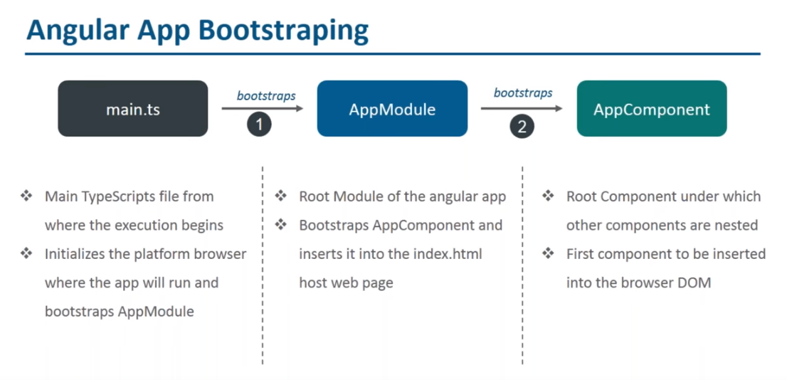

Slide 33
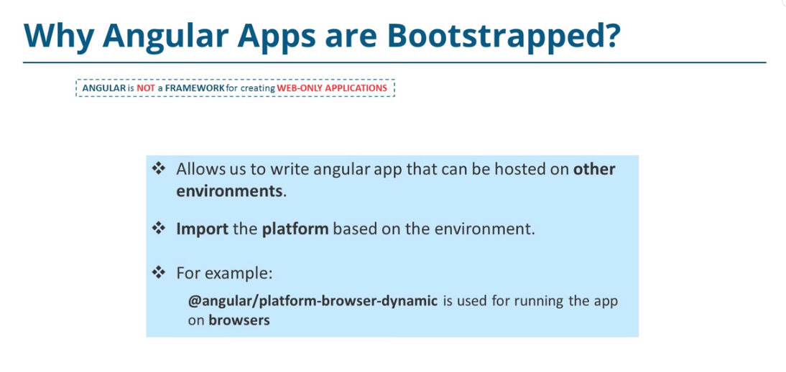

Slide 34
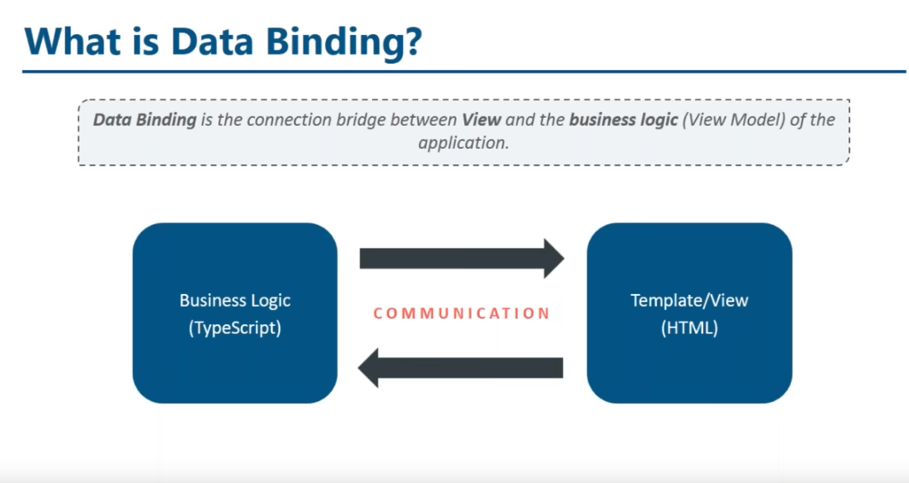

Slide 35
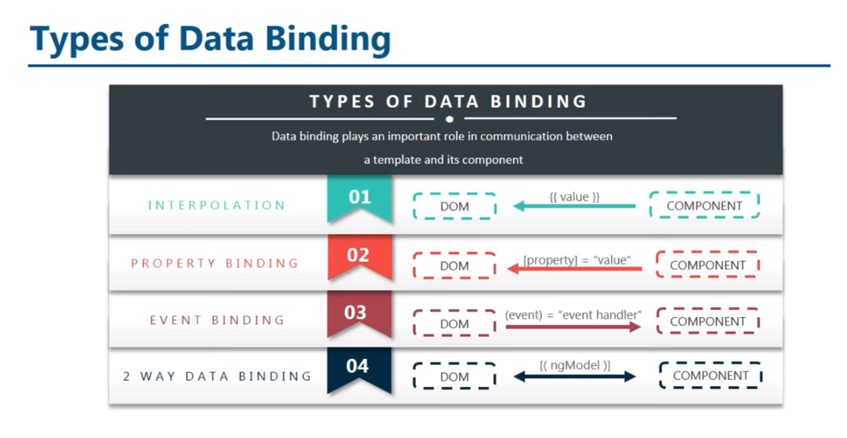

Slide 36
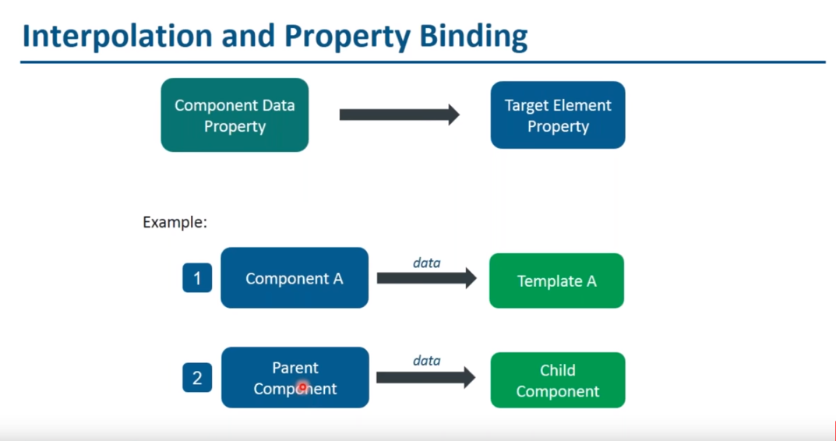

Slide 37
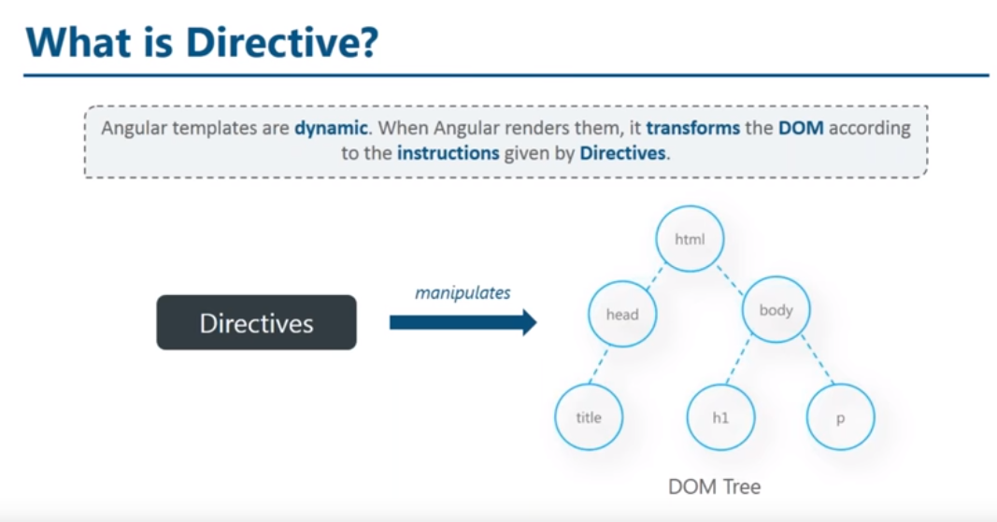

Slide 38
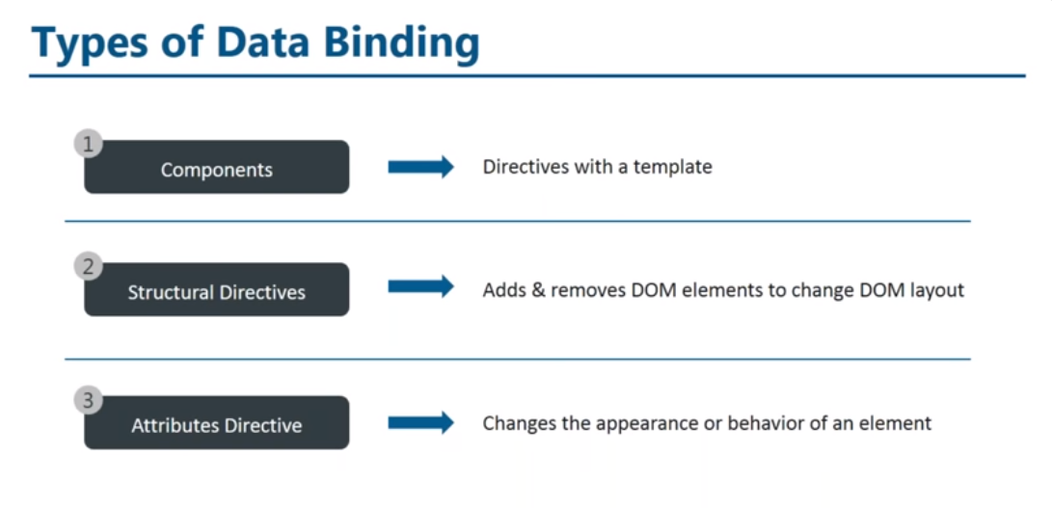

Slide 39
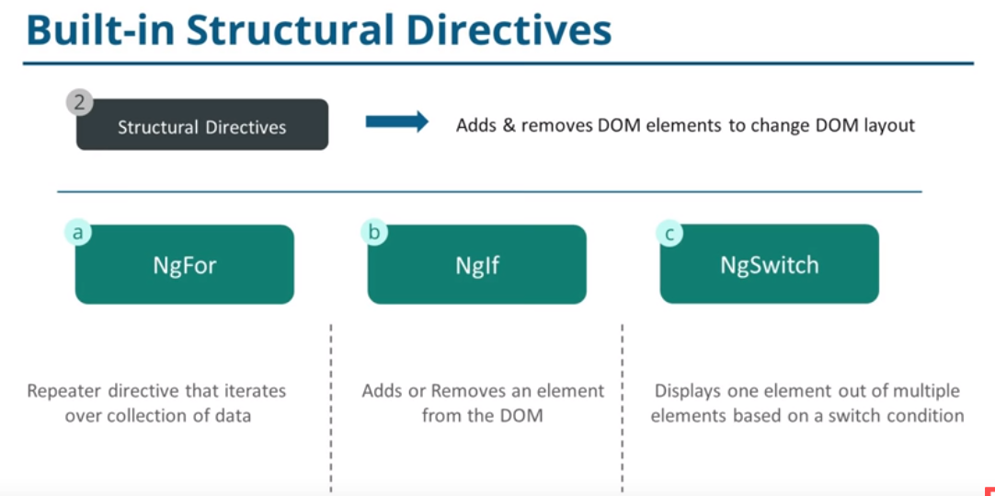

Slide 40
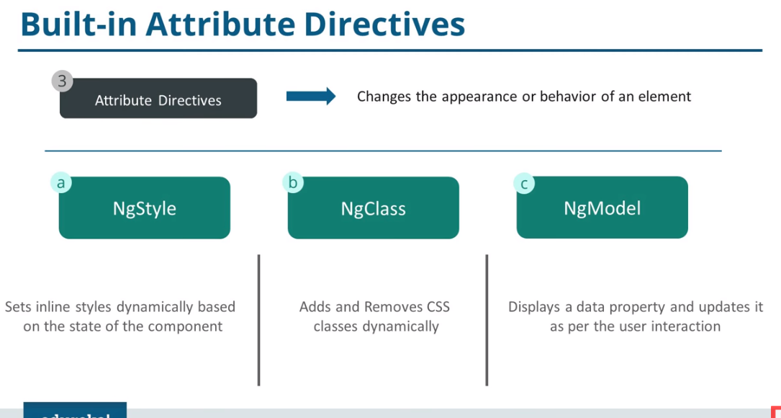

Slide 41
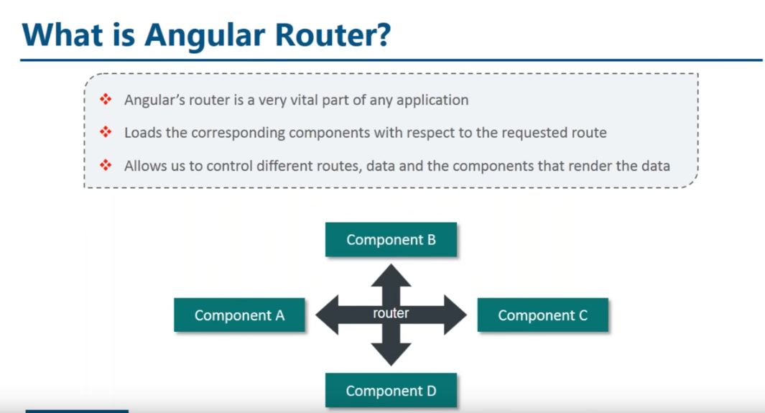

Slide 42
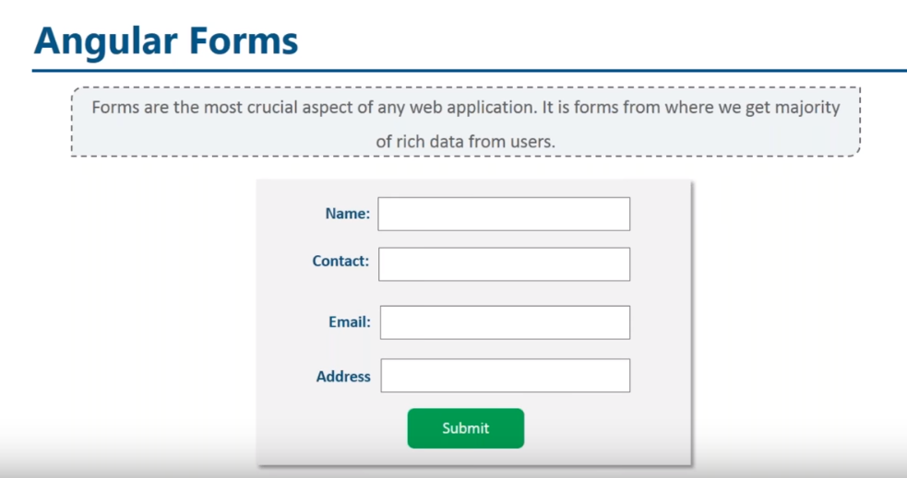

Slide 43
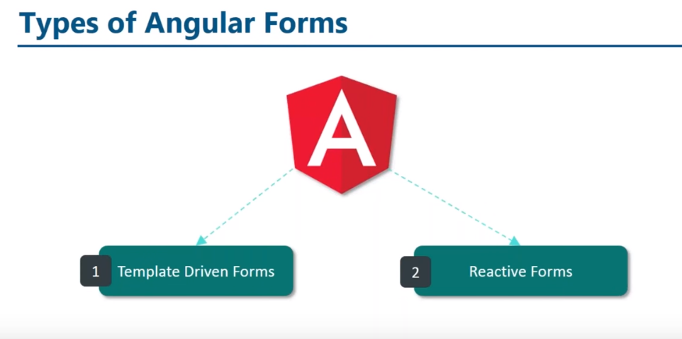

Slide 44
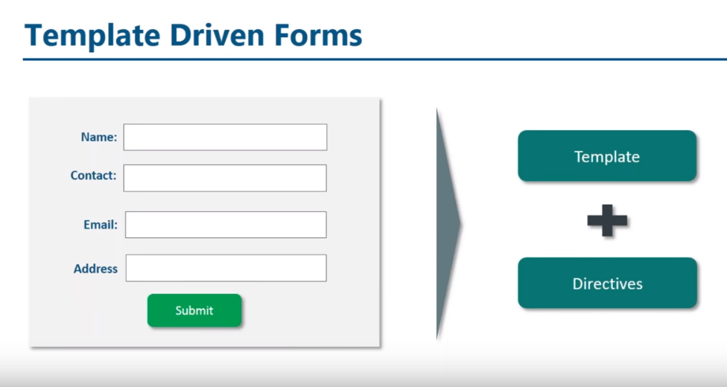
Steps:
Add FormsModule to app.module.ts.
Create a class for the User model.
Create initial components and layout for the signup form.
Use Angular form directives like ngModel, ngModelGroup, and ngForm.
Add validation using built-in validators.
Display validation errors meaningfully.
Handle form submission using ngSubmit.

Slide 45
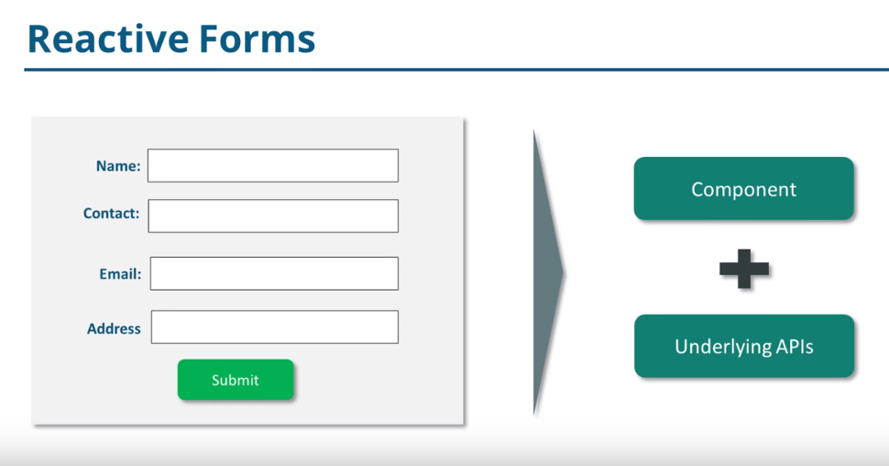
Steps:
Add ReactiveFormsModule to app.module.ts.
Create a class for the User model.
Create initial components and layout for the signup form.
Create and initialize the form control objects in our component class.
Add validation using Validators Class in our component class.
Display validation errors meaningfully.
Handle form submission using ngSubmit.

Slide 46
All the form validation logic will be located in a single place—inside your component class. This is way more productive than the template approach, where the ngModel directives are scattered across the template.
Unlike template-driven forms, Model-driven forms are easier to test. You don't have to resort to end-to-end testing libraries to test your form.
Validation logic will go inside the component class and not in the template.
For a form with a large number of form elements, this approach has something called FormBuilder to make the creation of FormControl objects easier.

Slide 47
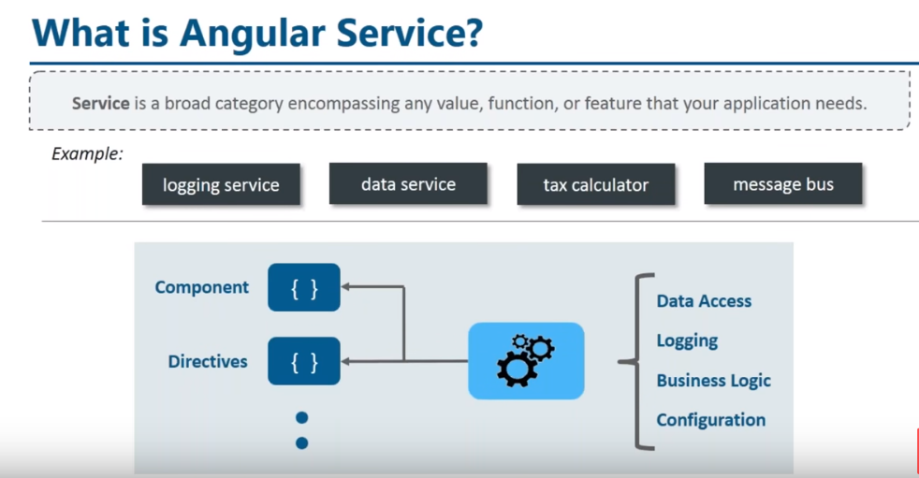

Slide 48
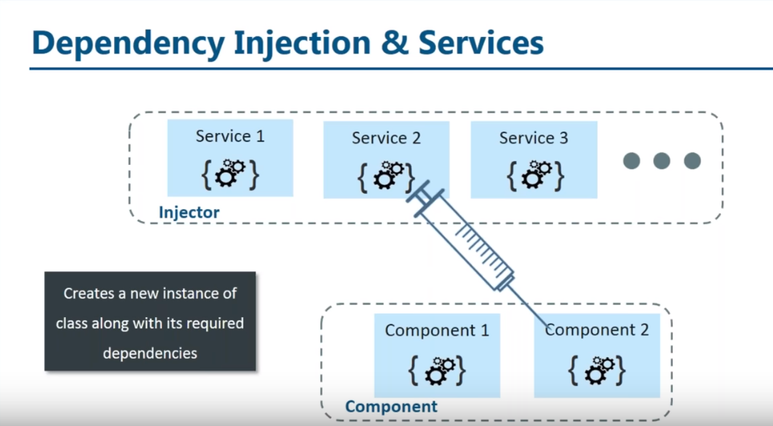

Slide 49


Slide 50






Slide 51


Slide 52
return this.http.get<SomeType>(url, {headers: this.headers})
.pipe(
map( response => { // NOTE: response is of type SomeType
// Does something on response.data
// modify the response.data as you see fit.
// return the modified data:
return response; // kind of useless
}),
catchError( error => {
return Observable.throw(error);
})
); // end of pipe

Slide 53


Wild Card /Re-Direct Routing

Slide 54





Thank You
Parag Joshi
+91 98233 17863
Parag.joshi@hematitecorp.com
www.hematitecorp.com

